Slide 1
APPLIED DATA SCIENCE WORKSHOP SERIES
From Raw Data
to Insight
Presenter : Terri-Ann Grant
Data Science Graduate Specialist
Contact: terrianngrant@scarletmail.rutgers.edu
WEEK 1
Graduate Data Scientist | Applied Data Science Workshop

Slide 2
Workshop Goals
By the end of today’s session, participants will:
Understand the full data analysis workflow
Work with a real-world dataset focused on digital inequity
Perform exploratory data analysis (EDA)
Create introductory visualizations
Extract meaningful insights from data
Begin thinking about how analysis supports decision-making
SESSION
OVERVIEW
EDA
Exploratory Analysis
VIZ
Visualisation
PAT
Pattern Finding
INS
Insight Generation
COM
Communication
Notes:
This workshop is designed to move beyond simply learning Python syntax. The goal is to understand how analysts approach real problems using data.

Slide 3
Why Applied Data Science Matters
Organizations increasingly rely on data-driven decision making
Data is now used to:
KEY POINT
Allocate Resources
Identify marginalized areas
RES
COM
“The value is not just in writing code.”
The value is in understanding patterns and communicating insight.
Support Policy Decisions
Improve Operational Planning
POL
OPS

Slide 4
Case Study: Digital Inequity in New Jersey
Our anchor dataset across the workshop series
Core Question
What factors are associated with disparities in internet access across New Jersey communities?
DATASET INCLUDES
WHY THIS DATASET?
Median household income
Broadband access rates
Education indicators
Geographic information
Real-world relevance
1
2
Policy implications
3
Combines Data Science + GIS + Public Analysis
Notes:
This project will serve as the anchor dataset across multiple workshops.

Slide 5
The Data Analysis Workflow
A structured approach to every analysis project
Define the Problem
Understand the Data
1
2
What question are we trying to answer?
What variables are available?
Clean & Prepare
Explore the Data
3
4
Handle missing or inconsistent values
Discover patterns and relationships
Generate Insights
Communicate Results
5
6
What does the analysis suggest?
Explain findings clearly to stakeholders

Slide 6
What is Exploratory Data Analysis (EDA)?
The foundation of any rigorous data project
Understand Structure
WHY EDA MATTERS
STR
Learn what variables you have and their types
“Good EDA often determines the quality of the entire project.”
Detect Patterns & Anomalies
PAT
Spot outliers, trends, and unusual values
Explore Relationships
REL
Discover how variables interact
EDA drives better hypotheses, cleaner data, and more defensible conclusions.
Generate Hypotheses
HYP
Form questions to investigate further

Slide 7
Hands-On Activities
Today’s collaborative notebook exercise
TODAY’S ACTIVITIES
TOOLS
1
Load the dataset into a Pandas DataFrame
Pandas
Data loading & manipulation
2
Inspect variables and data types
Matplotlib
3
Review summary statistics
Core plotting library
4
Check for missing values
Seaborn
Statistical visualisations
5
Generate initial visualizations
Google Colab
6
Discuss visible trends with the group
Collaborative notebook environment

Slide 8
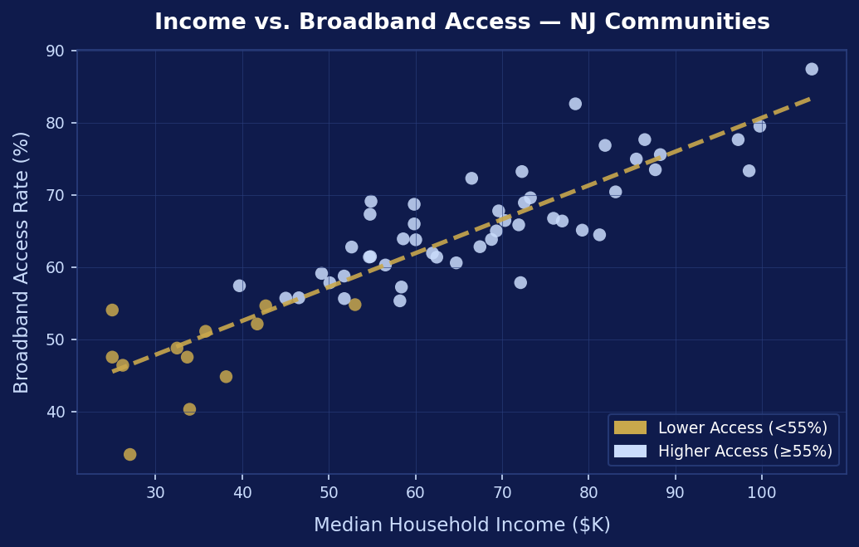
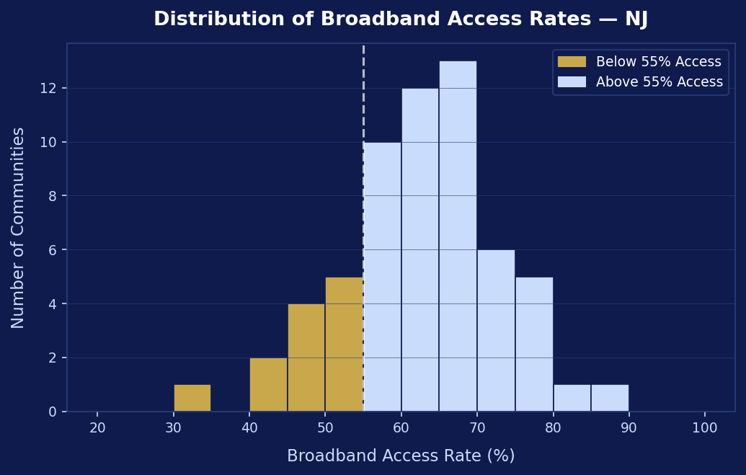
Visualisation Examples
What participants will produce in the Colab notebook
Scatterplot: Income vs. Broadband Access
Histogram: Distribution of Access Rates
Key Questions · Do higher-income areas show greater internet access? · Which communities appear underserved? · Are there visible disparities?
Notes:
Emphasise that visualisation is about understanding patterns quickly — charts let us see what tables can't.

Slide 9
From Charts to Insights
Data alone is not enough — interpretation is where value is created
What stands out?
Why might this pattern exist?
What info would help?
OBS
WHY
ASK
EXAMPLE INSIGHT
“Communities with lower median income levels appear to have significantly lower broadband access rates, suggesting income is a key predictor of digital inequity across NJ.”
Moving from description to explanation is the core skill of a data analyst.

Slide 10
Real-World Implications
Why digital inequity analysis matters beyond the classroom
Education Access
Remote Work
EDU
Digital access determines participation in online learning and remote schooling.
WRK
Broadband gaps limit employment opportunities for rural and low-income households.
Healthcare Access
Economic Participation
HLT
Telehealth and digital health services require reliable high-speed internet.
ECO
E-commerce, banking, and civic services are increasingly online-first.
Data analysis can support policy planning, resource allocation, and infrastructure investment.

Slide 11
Key Takeaways
01
Data analysis is a structured workflow — not just writing code
02
Exploratory Data Analysis is the foundation of every good project
03
Visualisation accelerates understanding and communication
04
Real-world data reveals meaningful, actionable patterns
05
Data science should always support better decision-making
From Raw Data to Insight | Applied Data Science Workshop Series | Week 1

